Slide 1
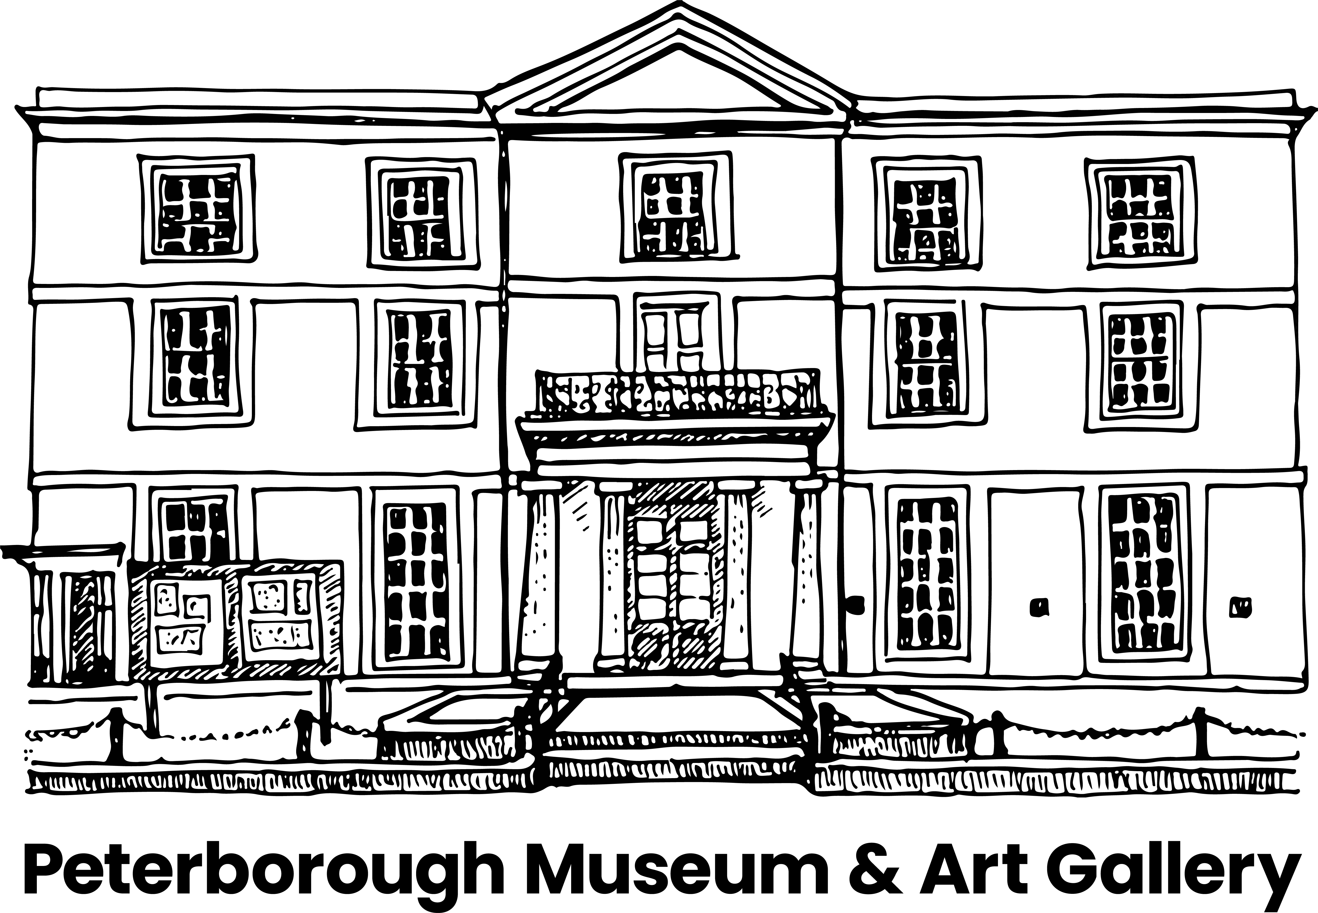
Alwalton Anglo-Saxon Cemetery
Alwalton is a village on the western edge of Peterborough
In 1999 archaeologists worked in Alwalton ahead of a business park development. The excavation was filmed for BBC TV's 'Meet the Ancestors'.
The archaeologists found an Anglo-Saxon cemetery
There were at least 61 burials in the cemetery, including 28 cremations. All dated to 500-600AD.
This cemetery was 'mixed rite'. This means there were Christian and Pagan burials.
Grave 1358 contained the remains of a woman and her possessions. Forensic techniques were used to reconstruct her appearance.

Slide 2
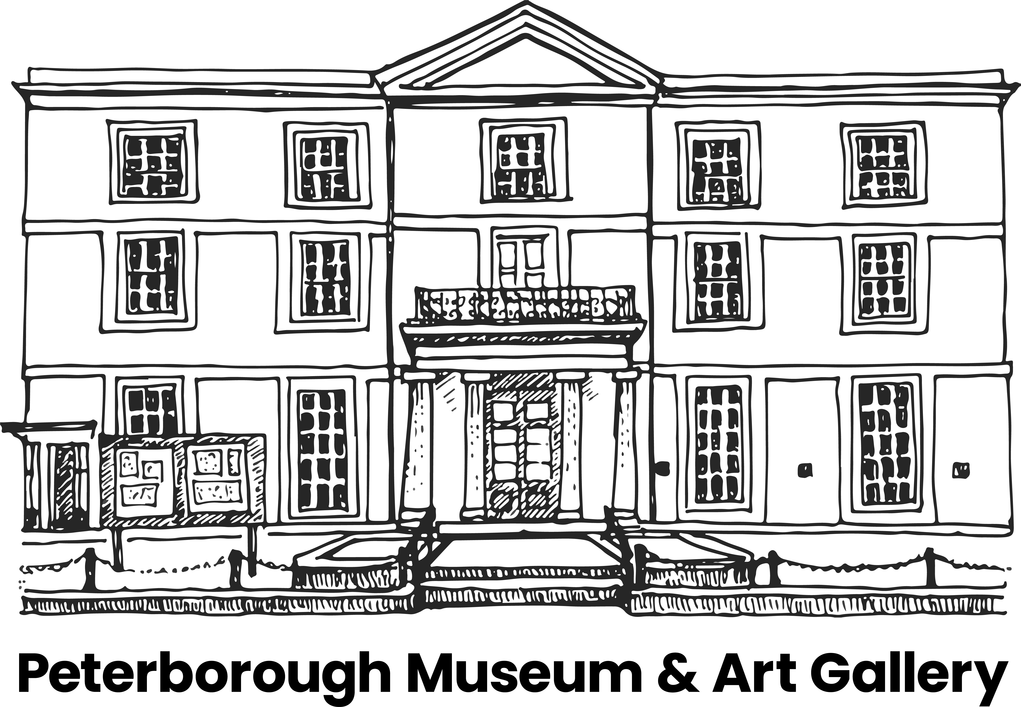
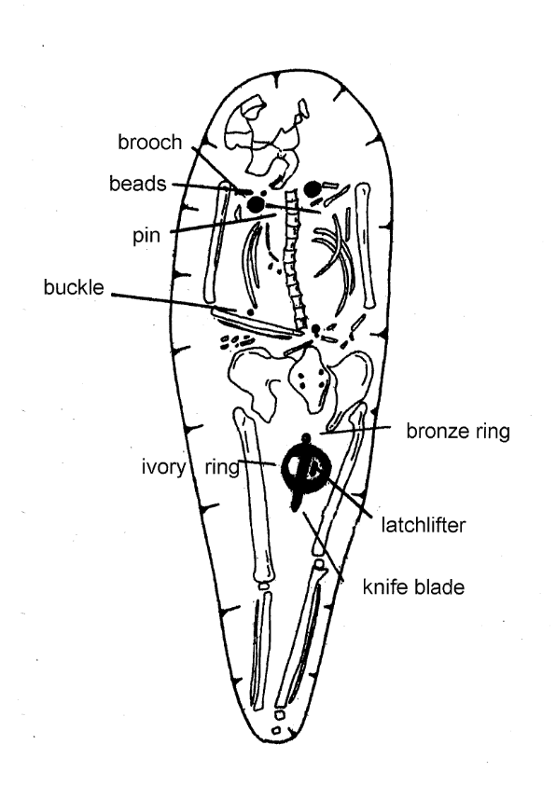
The Alwalton Woman
This is a drawing an archaeologist has made of the Alwalton Woman's grave. It means we can see exactly how the objects and skeleton were found before they were dug up.
With thanks to BBC TV and J.Brayne, Kincelm and Hertfordshire Archaeological Trust.

Slide 3
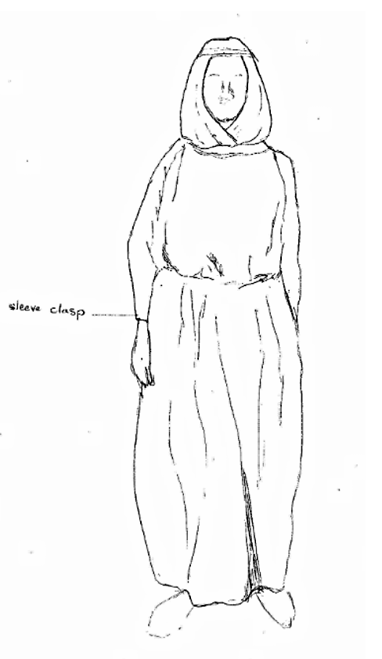
The Alwalton Woman
This is our idea of what the Alwalton Woman might have worn.
We have given you a list of her possessions, the objects that were found in her grave. Archaeologists call these grave goods. Can you draw them on and label the diagram with her possessions? We have labelled one for you. Why do you think she needed these items?
Sleeve clasp 2 disc brooches Bag hoop Girdle hanger
Long pin
Latch lifter
Knife blade
Beads
Buckle
Bronze ring

